Slide 1
Why Oracle for AI?
Presenter
Title
Date

Slide 2
Safe harbor statement
This presentation is intended to outline our general product direction. It is intended for information purposes only, and may not be incorporated into any contract. It is not a commitment to deliver any material, code, or functionality, and should not be relied upon in making purchasing decisions. The development, release, timing, and pricing of any features or functionality described for Oracle’s products may change and remains at the sole discretion of Oracle Corporation.
Statements in this presentation relating to Oracle’s future plans, expectations, beliefs, intentions, and prospects are “forward-looking statements” and are subject to material risks and uncertainties. A detailed discussion of these factors and other risks that affect our business is contained in Oracle’s Securities and Exchange Commission (SEC) filings, including our most recent reports on Form 10-K and Form 10-Q under the heading “Risk Factors.” These filings are available on the SEC’s website or on Oracle’s website at http://www.oracle.com/investor. All information in this presentation is current as of January 2024 and Oracle undertakes no duty to update any statement in light of new information or future events.

Slide 3
“The true potential of AI lies not in replacing humans but in empowering them. It’s about creating a synergy where machines and humans collaborate to achieve unparalleled efficiency and innovation.” Fei-Fei Li, Co-Director of Stanford’s Human-Centered AI Institute
Notes:
The value of AI for enterprise is no longer being discussed on just the experimental level. Instead, we’re entering a new era of productivity and seeing how AI, combined with human ingenuity, is pushing past the boundaries of what we previously thought was possible.
Today, successful generative AI is focused on solving real-world enterprise use cases. And Oracle has been innovating to build practical AI to help customers solve business problems both smarter and faster. Let’s look at a few examples of how this has been done.

Slide 4
SaaS Apps
Oracle brings AI to the enterprise at every layer of our stack
Partners
AI Services
Data
Infrastructure
Notes:
Now the key with these new innovations is that they are all part of our broader AI strategy of offering an enterprise grade service in OCI, while also continuing to offer built-in AI in our data platform with Oracle Database, HeatWave and Autonomous. All on top of an AI Infrastructure based on our Supercluster technology
From infrastructure:
Built-on Supercluster technology
Native support for bare metal instances
NVidia A100 and H100 GPUs
Scalable to tens of thousands of GPUs
Local NVMe storge
To our modern data platform
Oracle Database and Oracle Autonomous Database
-Vector DB
-Select AI
MySQL HeatWave
To our Fusion and other SaaS apps:
Helping Fusion customers get more from AI
- Example 1
- Example 2
- Example 3
Transition to customer stories/use cases:
Now what we find is that while there is a lot of the AI tech is out there, customers are still struggling to further solving their problems with the technology. That’s why I want to focus on some key use cases today.

Slide 5














Tech innovations across the Oracle AI stack
Applications
AI Partners and ISVs
Fusion Applications
Fusion Analytics
NetSuite
Industry Applications
3rd Party Applications
Embedded Generative and Classic AI
AI Services
Generative AI capabilities
GenAI
GenAI Agents:
RAG, Code Assist
Digital Assistant
Speech
Language
Vision
Document Understanding
Generative AI and ML for Data Platform
Oracle Database 23ai
AI Vector Search
Autonomous Database Select AI
HeatWave Vector Store and GenAI
Data Science
ML in Oracle Database
HeatWave AutoML
Data Labeling
Data
AI Infrastructure
Supercluster with RDMA networking
Compute GPU: bare metal, VMs, Kubernetes
Block, Object, File Storage, HPC filesystems
Distributed Cloud
Public
Government
Dedicated
Sovereign
Alloy
Notes:
By embedding AI throughout the entire technology stack - from the infrastructure that businesses run on, through to applications for every line of business from finance to supply chain and HR - Oracle is helping organizations pragmatically use AI to improve performance while saving time, energy, and resources:
Our core cloud infrastructure now includes a unique AI infrastructure layer based on our Supercluster technology, leveraging the latest and greatest hardware, and uniquely able to get the max out of the AI infrastructure technology for scenarios such as LLP - Large Language Processing.
On top of this infrastructure, our database layer embeds AI in our products such as our Autonomous Database and MySQL HeatWave with AutoML (built in Machine Learning), to enable developers to add prebuilt models to applications and operations without being experts in technologies such as ML
And our application development platform provides AI services such as Oracle Digital Assistant for NLP (Natural Language Processing).
In addition, Oracle's broad range of industry applications embed AI models that are trained to tackle the specific challenges of industries ranging from healthcare and financial services to retail, manufacturing, and the public sector. This puts us in a unique position to help our customers optimize workloads to solve the most complex and strategic challenges.

Slide 6
OCI Generative AI
Notes:
Demo – see what you can do with generative AI today. Available now.

Slide 7
Generative AI innovation at Oracle
Deliver high-performance generative AI
Embed generative AI across every layer of the tech stack
Prioritize data management, security and governance
Notes:
Generative AI can drive innovation, improve processes, and help companies accomplish more than ever before-–but it requires the right approach.
Oracle continues to make the best of AI available to enterprises everywhere, with a unique focus on high performing models, embedding generative AI across the stack, and data management, security and privacy

Slide 8





Use cases across business functions
Customer Operations
Marketing
Sales
Product Development
Strategy and Finance
Automated customer service based on customer’s product suite, experience and language
Content generation for ecommerce (product descriptions), B2B (articles optimized for SEO) in brand voice
Custom sales outreach based on interaction history, prospect profile to free up sales rep time
Analysis, cleaning, and labeling large volumes of data, such as user feedback, market trends, logs
Synthesis of unstructured data from earnings calls, analyst reports and other sources
Real-time AI call scripts based on conversation history and caller context
Mass personalization of search, outreach, customer nurture based on buyer profile and usage history
Virtual sales representatives that guide prospects through offerings through to a sale
Coding and API auto-completion to speed up development,, refactoring, and systems integration
Automation of complex, context heavy processes like expensing, AR
Synthesis, clustering of unstructured customer data to identify new trends and personas
At scale monitoring of competitors, customers, across public, private sources
Post call agent feedback on call performance, ways to optimize future calls
Custom sales pitch generation for new customers based on existing content
Testing automation through creation of synthetic data, and compilation of log data
8
Copyright © 2024, Oracle and/or its affiliates
Notes:
But what are some common LLM use cases? This is a bit more of a reference slide (so, feel free to take a picture). Generative AI capabilities lend themselves to a variety of operational use cases depicted here, including … [list out a few of your favorites]

Slide 9





OCI Generative AI
Built from the ground up to meet your enterprise needs
Dedicated AI Clusters
Peace of mind knowing you have the compute resources you need. Predictable performance and pricing
Tailored to your enterprise needs
Fine tune models to meet your enterprise specific needs.
OCI Generative AI
Private custom models Custom models trained on your data can only be used by you.
Bring state-of-the-art AI to your data
Take your data and applications to the next level by incorporating generative AI into existing workflows.

Slide 10
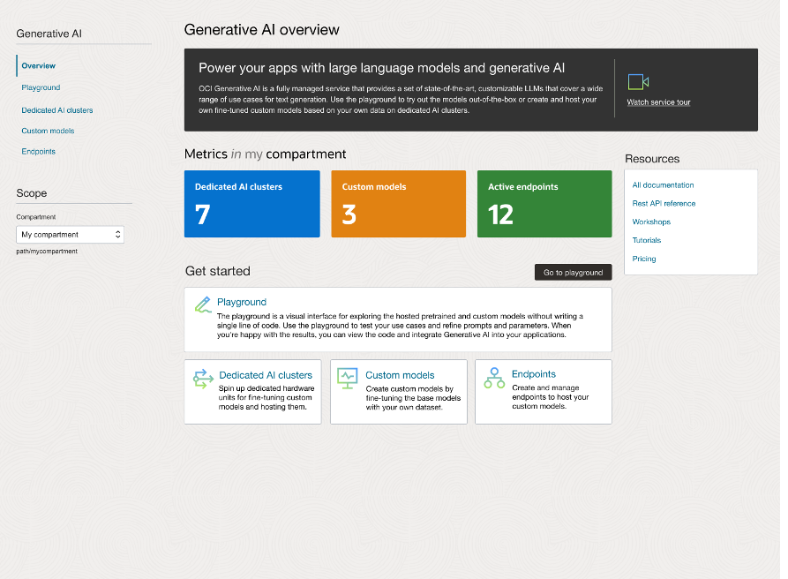
OCI Generative AI service
High quality pre-built models We are offering high quality models from Meta and Cohere to meet your business needs with minimal effort
Customize models to meet your needs Fine tune models with your own data and focus on your most important tasks
Fully hosted inside OCI All processing and data storage happens inside OCI, no cross-region or cross-cloud communication
Private and secure Customer-provided training and inference data is not sent to Cohere or Meta and cannot be seen by other customers.
Notes:
As we continue to deliver on our AI strategy, we’re announcing the general availability of OCI Generative AI, a managed service available via API to seamlessly integrate LLMs into a wide range of enterprise use cases.
It’s an easy to use, fully managed service for using generative AI. We’ve partnered with Cohere and Meta to bring the best models for business into our platform so they can be used to power the next generation of applications and business processes built on OCI. The service is available to use today and we’re going to look at what makes it so powerful for the enterprise.

Slide 11
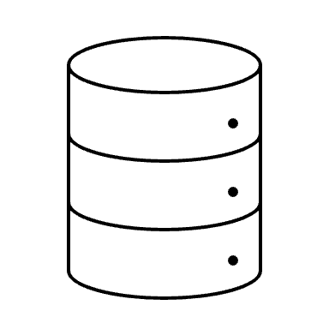
OCI Generative AI Agents: What is an Agent?
Interface
An AI AGENT is an LLM-based program that can:
Perform complex tasks on its own
Mimic human chain-of-thought processing
Be an effective tool for automating processes
Short / Long Term
Memory
Large
Language
Model
Tools
Reasoning
Acting
Persona
Knowledge
Base
Prompt
Planning
Response Generation

Slide 12


What is RAG?
Embeddings
Model
Databases
User Prompt
Large Language Model
Applications
RAG
Business Data + Semantic Data
Public Data + Private Data
Business systems
Notes:
Put simply, RAG adds an information retrieval aspect to a generative AI model. One example of how this manifests is providing a prompt to an interface, and having the generative AI model retrieve a result with information directly from existing databases and applications. Think of what this can do for your workplace: your skilled employees, plus the knowledge of the internet at large, combined with your specific company’s proprietary information, combined with the ability to command a model to interface with business applications, all resulting in the ability to generate more employee output and productivity.
Implementing a RAG solution is a top priority at enterprises, both large and small, and Oracle provides all the data models needed—vector, graph, spatial—for a complete semantic search capability. With other approaches organizations only have a vector database but are missing the contextual requirements that spatial and graph data can provide. And Oracle goes a step even further, by providing its business apps to this mix as well.

Slide 13
Why is RAG important?
LLM Challenges
RAG
In attempts to answer questions outside of expertise, LLMs can hallucinate
Mitigates hallucinations by grounding answers in enterprise data
LLMs are “frozen in time” and updating training sets is generally cost prohibitive
RAG brings in up-to-date data
General models lack domain or enterprise specific data and are suited for generalized tasks
RAG extends model by incorporating domain and enterprise specific data
LLMs are black boxes and lack the ability to reference citations / source of data
RAG can provide citations for generated responses
Most organizations do not develop foundation models
RAG provides a mechanism to “extend” foundation models
13
Copyright © 2024, Oracle and/or its affiliates

Slide 14
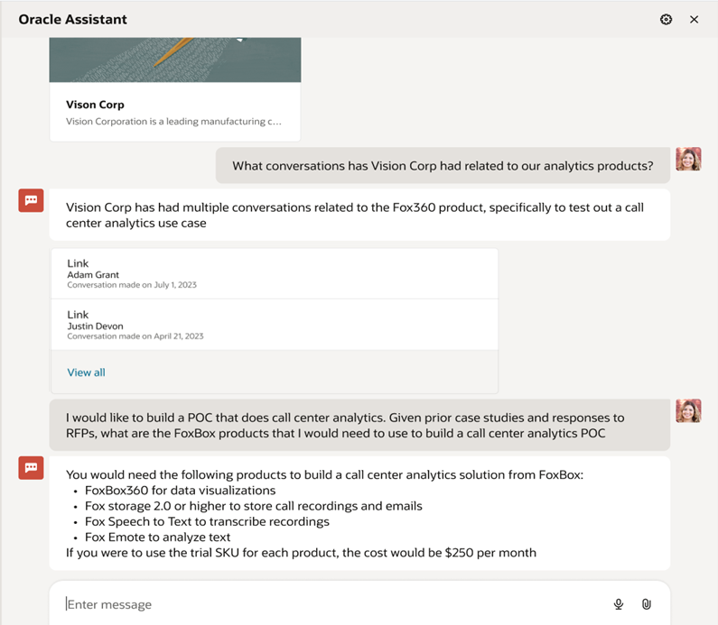
OCI Generative AI RAG Agent
OCI GenAI RAG Agent connected to company’s knowledge bases
Analyst asks a natural language question
GenAI RAG Agent responds in humanlike manner and provides links to relevant source documents
Analyst asks a follow up question
GenAI RAG Agent uses chat history and further information retrieval to respond

Slide 15
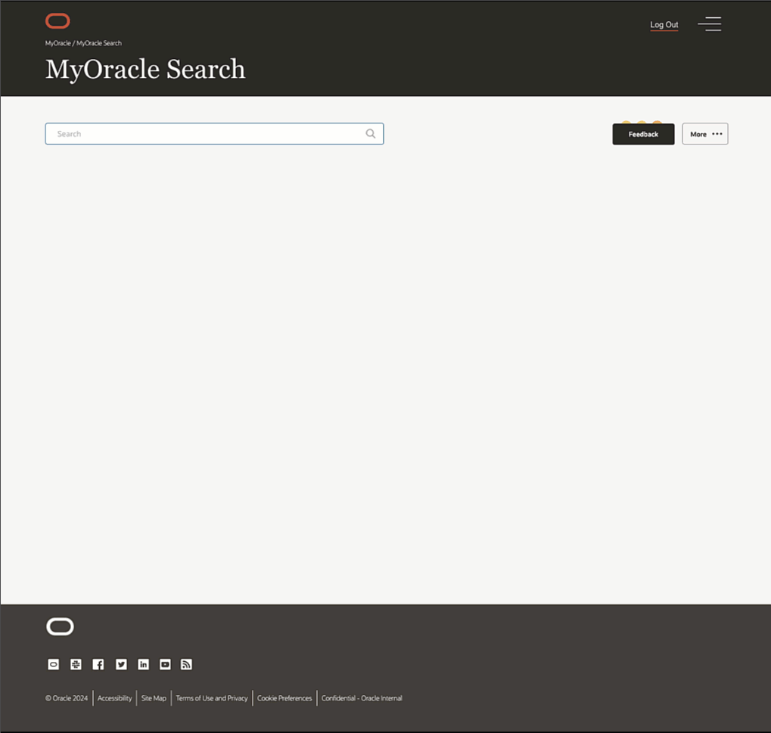
Use cases
Oracle
Challenge:
Employees struggle to find answers within vast amounts of internal Oracle microsites and documents, e.g., IT and HR
When answers aren’t found IT tickets or emails to HR are generated asking for help
Solution:
MyOracle Search uses OCI Generative AI plus RAG to enable natural language interactions to find answers fast
Answers are provided directly inline and are grounded with references to original source materials
Benefits:
Employees are more productive and self-sufficient
25-30% of common IT requests are answered by generative AI allowing IT agents to focus on complex tickets
Notes:
In this example, MyOracle Search – HOW DO I RESET MY VPN PASSWORD
- Firstly retrieves results on the natural language query using lexical and semantic search. This retrieves a list of relevant documents that answer the request. In this IT support docs on resetting the VPN password.
- Then it uses GenAI to create a list of steps to follow inline – in this case the exact steps to reset the VPN password without having to open any docs (the first highlight callout box)
- It also provides grounded answers by including references to the actual documents that were used to generate the AI natural language response. (the second highlight callout box)

Slide 16
Oracle AI and Data Science Services
Notes:
Demo – see what you can do with generative AI today. Available now.

Slide 17




AI Services
Benefits
AI for everyone
Prebuilt for enterprise requirements
Customizable for your needs
Best-in class support
An AI starting point, even without data science experience
State-of-the-art LLMs from Meta and Cohere for generative AI use cases
Prebuilt models trained on industry-derived data
Optimized for use cases across finance, manufacturing, and more
Built-in insight highways into your SaaS applications with Oracle NetSuite, Fusion, and custom apps
Tailor your AI models without data science experience
Save costs by training AI models already on OCI
Fine tune generative AI models for specialized use cases
White glove treatment
Data scientists on staff, dedicated to ensuring your organization’s success
Pricing to support AI experimentation

Slide 18
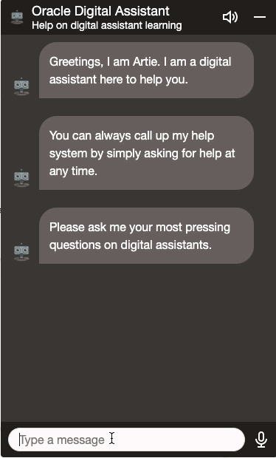




OCI Digital Assistant
Intelligent self service chatbot providing chat, text message, and voice interfaces
Improve self-service experiences with chatbots, voice interfaces, intuitive search
Reach new audiences by creating new application interfaces and dashboards
Create more intelligent customer experiences with added personalization, prediction, analytics, and more
Notes:
Platform to build intelligent chatbots
Intent Classification & Entity Extraction
Built in speech recognition
Business level insights into usage and adoption
Scenarios
Customer support
Human Resources frequently-asked-questions
Improve customer facing website functionality discoverability through natural language

Slide 19

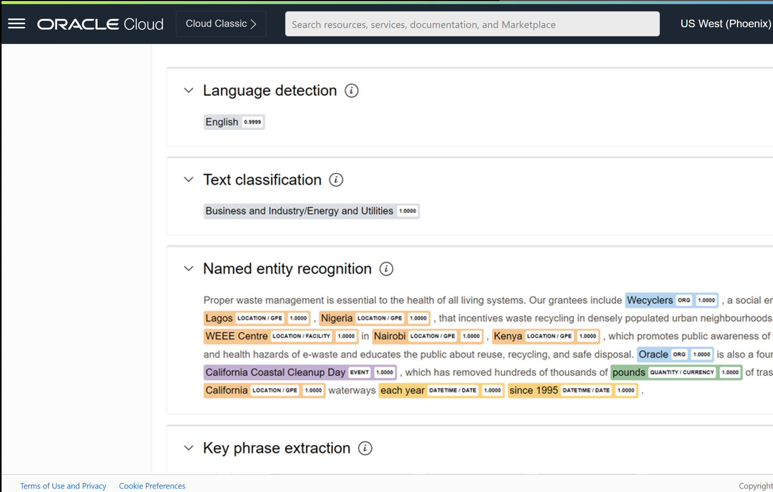
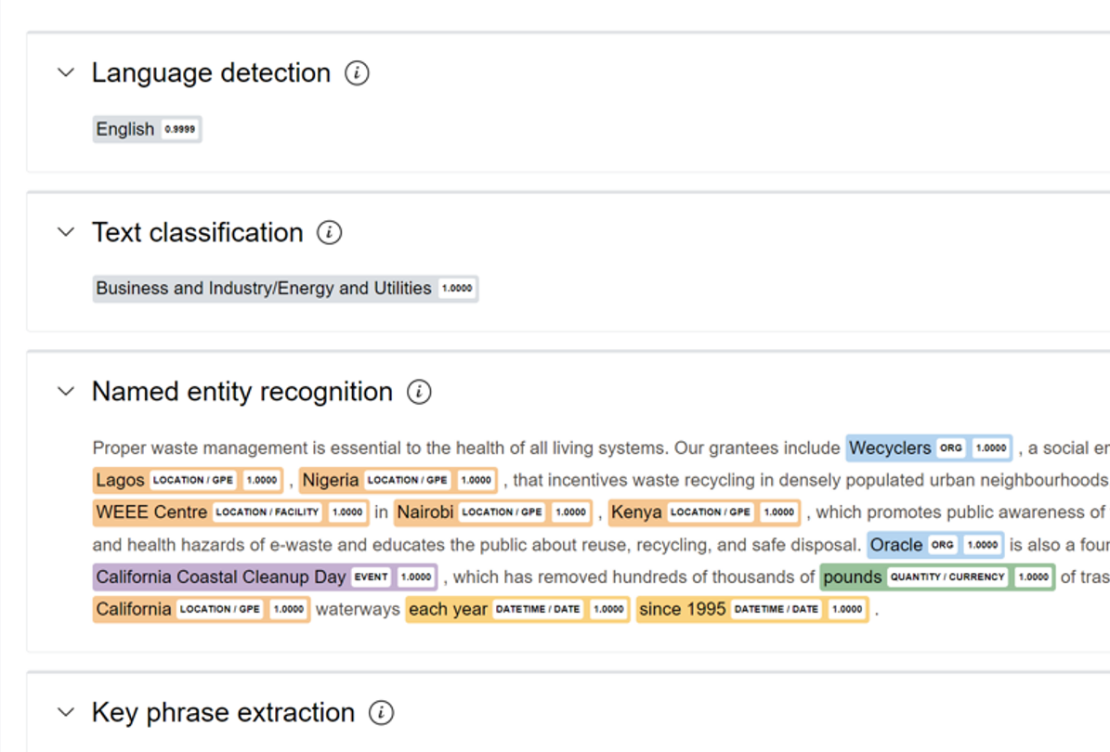
OCI Language
Text AI to classify sentiment and extract important entities
Analyze text at scale
Translate to/from 20+ languages to easily reach new audiences and consumers
Improve user experience by understanding sentiment from text
Recognize sensitive information to protect privacy and ensure compliance
Notes:
State of the art natural language processing at your fingertips -- no data science expertise needed
Common use cases
Analyze customer feedback – product reviews, support tickets, call center interactions, social media posts, etc.
Streamline and automate document centric processes – contracts, RFPs, financial documents
Content localization, and real time translation.

Slide 20


OCI Speech
Input Audio Signal
Transcribe spoken audio with multilanguage support
Create searchable, indexed data by transcribing audio files
Filter profanities and leverage confidence scores
Combine with Language or other AI services to analyze sentiment, translate to other languages, and extract key information
OCI Speech
Output Text
Text Transcript “Good afternoon, everyone, and welcome to Oracle's fourth-quarter and fiscal-year 2021 earnings conference call. A copy of…”
Notes:
Automatically transcribe your audio and video files into text using advanced deep learning techniques.
No data science expertise required
Process data directly in object storage, no data movement needed
Generate timestamped grammatically accurate transcriptions

Slide 21
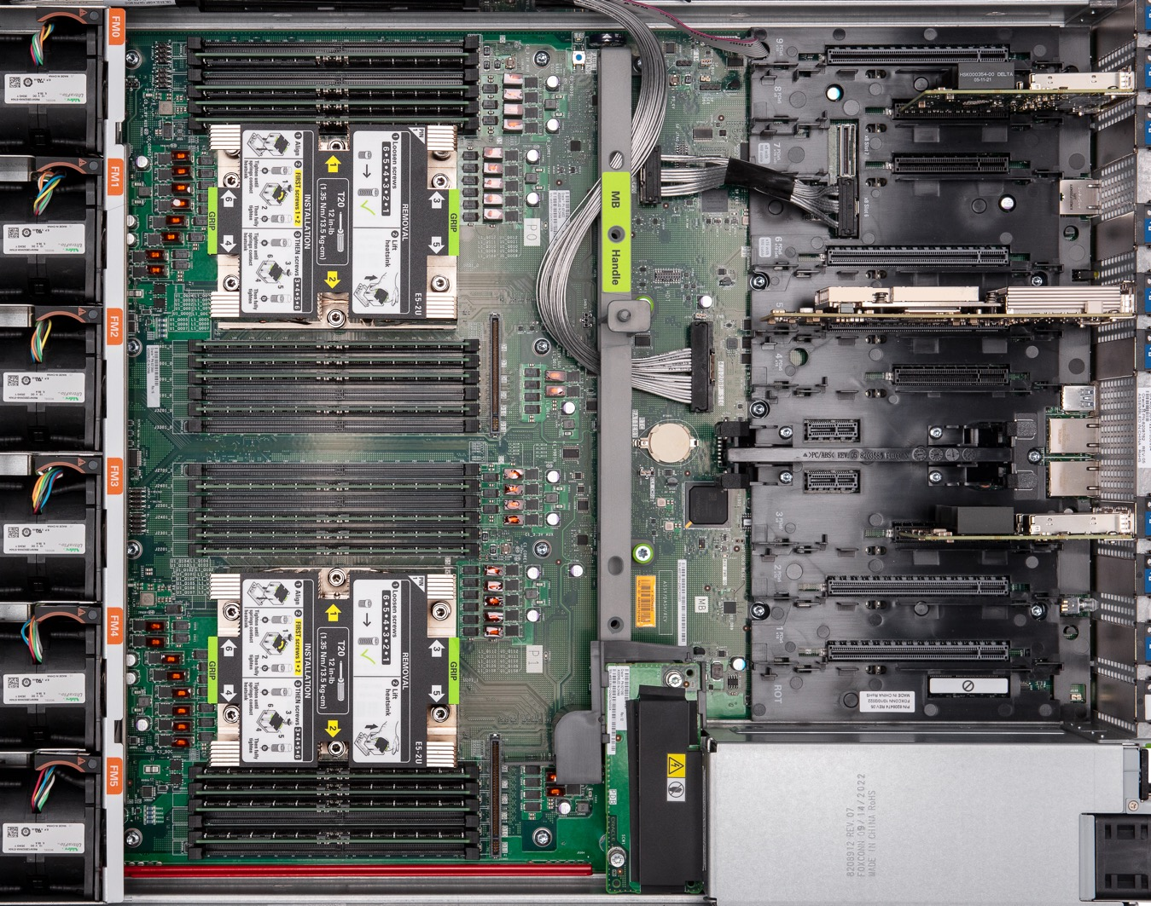
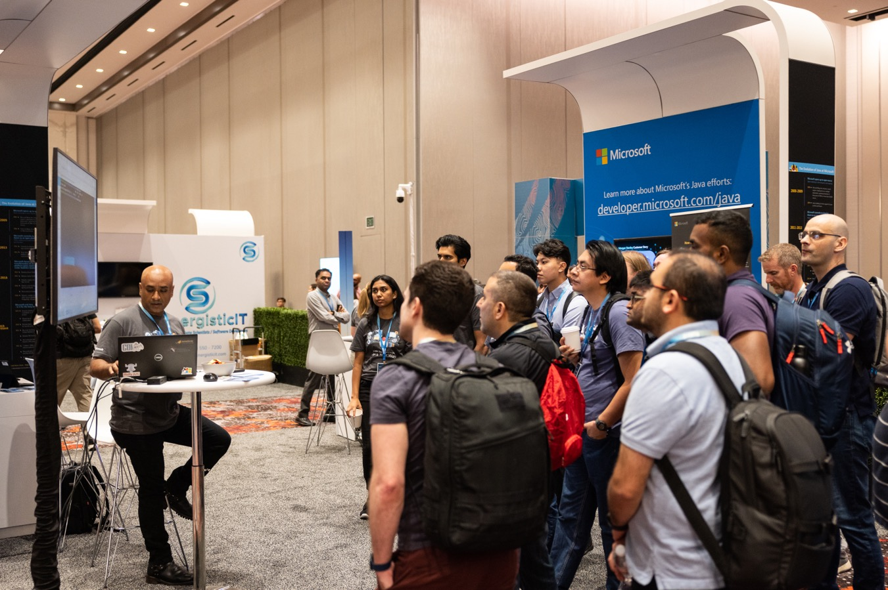
OCI Vision
Understand images and detect objects
Automate workflows and actions based on image analysis
Gain insights from visual data by automatically extracting text and objects
Enrich image-based files with metadata, including objects and colors for better indexing and retrieval in a digital asset management system
Notes:
Automatically transcribe your audio and video files into text using advanced deep learning techniques.
No data science expertise required
Process data directly in object storage, no data movement needed
Generate timestamped grammatically accurate transcriptions
Prebuilt and Custom Image Analysis
Object Detection
Image Classification
Face Detection (LA)
Custom
Train a model with your own examples. Complete integration with OCI Data Labeling simplifies data labeling and provides more accurate models
Object Detection
Image Classification

Slide 22
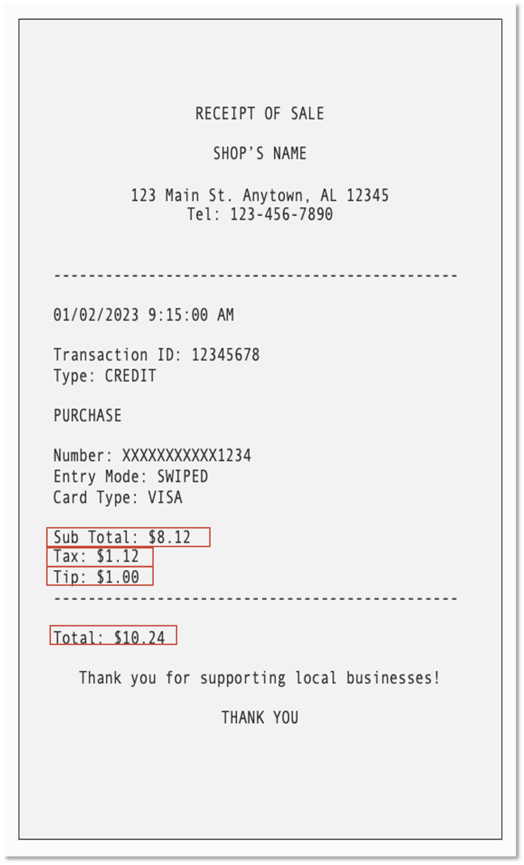

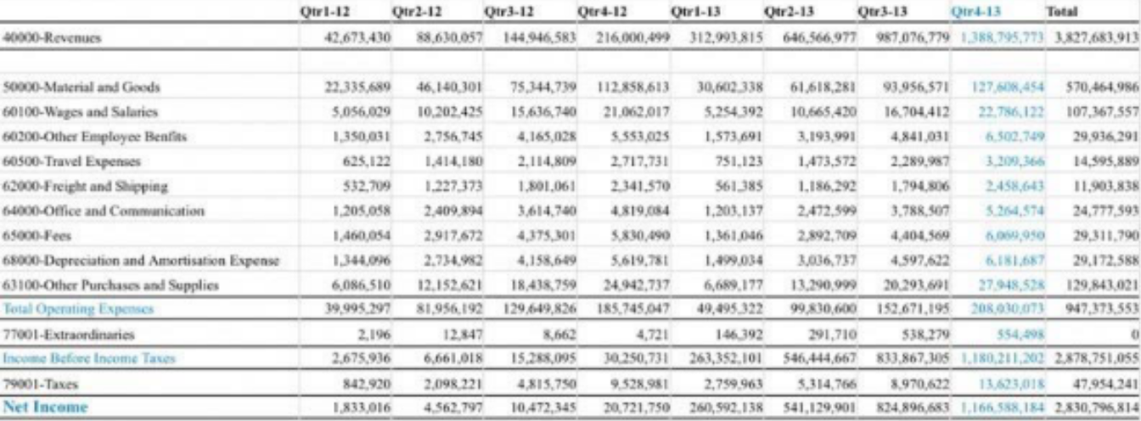
OCI Document Understanding
Recognize and extract text, tables, and key data
Extract text from scanned documents, mobile uploads, PDFs, and more
Preserve table formats and key value relationships recognized in documents
Easily automate tedious business processes based on data output in JSON format
Pretrained using enterprise focused data, providing accurate results for enterprise focused use cases
Notes:
Text recognition
Language detection
Prebuilt document classification
Custom document classification
Pre-built key-value extraction models
Invoices
Receipts
Driver licenses
Passports
Table extraction

Slide 23



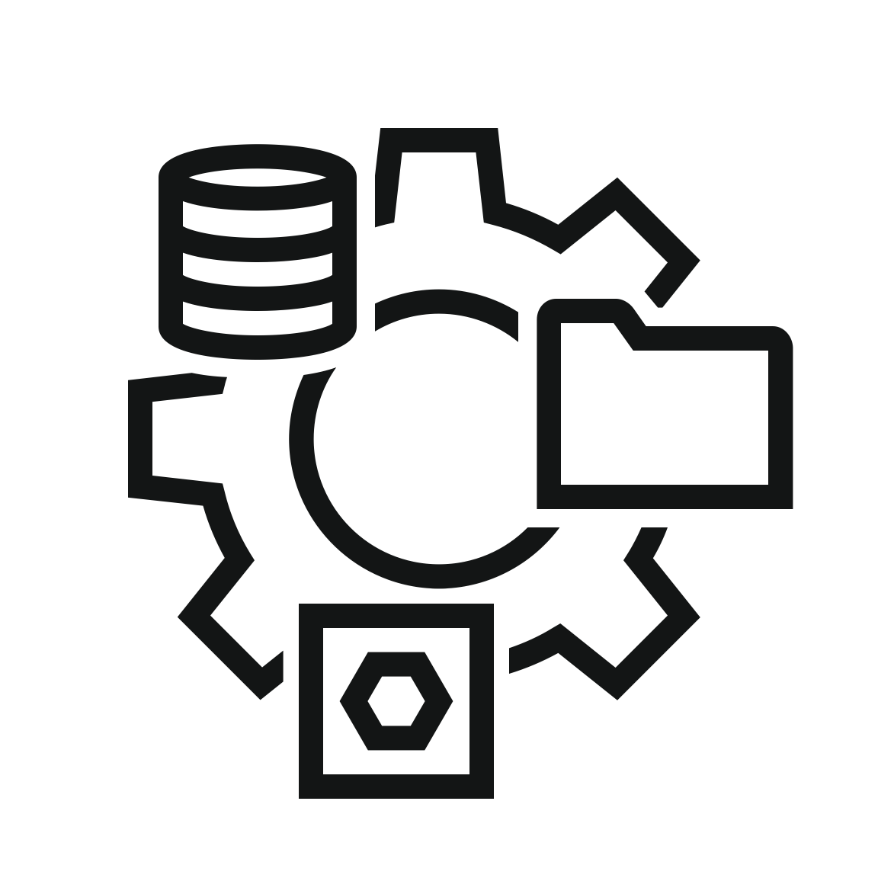





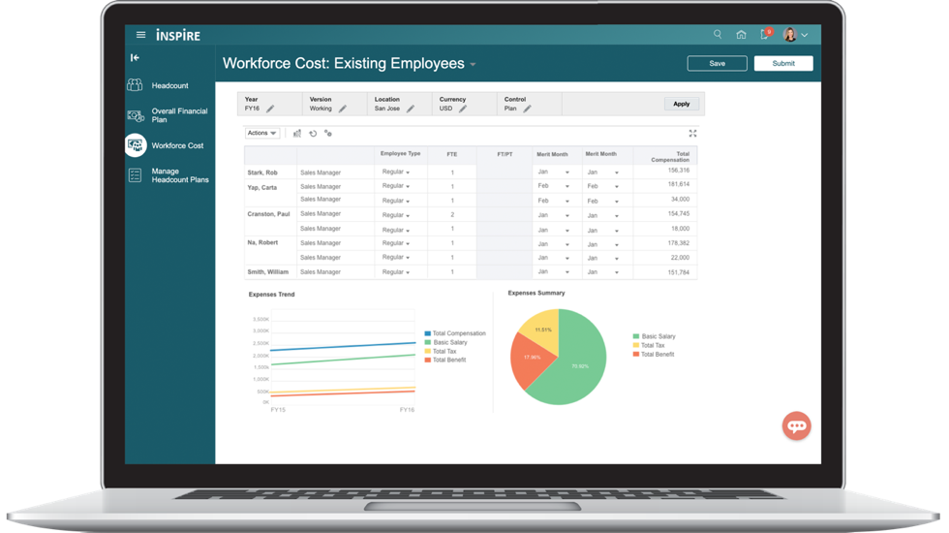
OCI Data Science
Oracle Cloud Infrastructure
Data Science
Develop & Experiment
Manage, Share, & Reproduce
Open and extensible
Notebook Sessions
Local and OCI Code Editors
Model Catalog
Feature Store*
Conda Environments
Use your favorite open-source tools and framework
Use your AI anywhere using ONNX
Accelerated Data Science SDK available as an open-source library
Operationalize with MLOps
Integrate
Jobs
Pipelines
Model Deployments
Model Monitoring*
ML Applications*
Data Management
Database – Data Lake – Access – Integration – Preparation
Infrastructure
CPU – GPU – Storage – Network
*Coming soon
Notes:
Accelerate and automate the e2e data science lifecycle.
Software configuration out of the box… easy to get started.
Flexible interfaces: deploy models created elsewhere, OCI CLI, SDK, local and cloud development, managed service path.
Differentiation
----------------------
HW we can run on.
We are close to your data
Ease of use (training and deployment pipeline)
Cost and performance
OCI
----
Dedicated region
HW
Cost
SaaS – we can handle (200MM inference requests / month just for Fusion)
Data management offerings
Last but not least, we’re doing all of this the right way.
With Oracle AI, you can use your favorite 3rd party and open-source tools.
In OCI Data Science, curated Conda environments containing all the popular open-source libraries are provided for data scientists to use for many different use cases. Users can also easily add others and create their own Condas. Oracle also enables users to bring in their own tools directly to OCI.
Use your AI anywhere
A machine learning model built with Oracle AI can be ported anywhere—compute cluster, phone, or edge device. Rather than creating proprietary formats, Oracle uses machine learning open standards like ONNX so that ML models will be portable to virtually any platform. Using these standard formats makes it easier for developers and analysts to take a model trained with Oracle AI and deploy it elsewhere, or take a model trained elsewhere and bring it to OCI.
Partnerships to enhance AI
Oracle works with NVIDIA to support the latest GPUs, Intel to support high-frequency Intel AMD CPU shapes, and open-source providers to support various frameworks.
Oracle is announcing a partnership with the world’s most popular open-source data science ecosystem of ML libraries in Python, Anaconda. Anaconda has recently created a new online learning platform for the Python and R community, called Nucleus. To facilitate data science learning for users at all levels, Oracle will host Nucleus walkthroughs on its cloud platform and provide a way for users to sign up for Oracle Cloud’s Free Tier to experiment with machine learning without any cost.
Committed to open source
We are announcing the upcoming open source release of the ADS library, part of OCI Data Science, so the ADS client library will be accessible from anywhere. This gives data scientists the ability to call our services, integrate ADS in their pipeline, and build, train, and deploy their models with ADS to OCI Data Science from their laptop. Now data scientists can build locally, and deploy to the cloud.

Slide 24
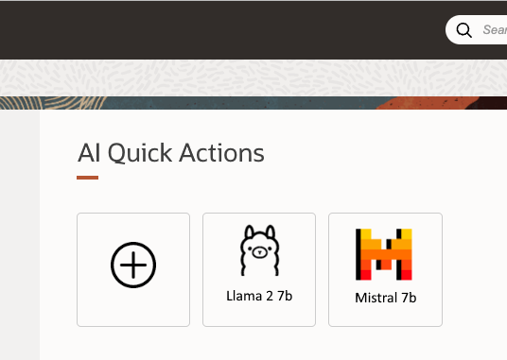

AI Quick Actions for OCI Data Science: June 2024 Update
A collection of use cases that can be invoked in a click of a button, all in a user interface inside the Data Science notebook experience.
Model families include:
Llama
Mistral
Gemma
Falcon
ELYZA
And more
Quick actions:
Deploy
Fine Tune
Integrate
Scale
Notes:
OCI Data Science AI Quick Actions is a no-code feature of the OCI Data Science service that enables access to a wide range of open source LLMs, including options from Meta, Mistral AI, and more. Once generally available, this feature will provide wider access to the best of what the open-source community offers.
OCI Data Science Quick Actions provides access to curated models that users can fine tune, evaluate, and deploy with their data, but also encompasses a comprehensive ecosystem with user-friendly workflows, integrated telemetry and visualizations, and simplified execution processes.
Some of the initial available Quick Actions include the following examples:
Fine tuning Llama 2 foundation model
Deploying Mistral 7B foundation model
Deploying Llama 2 13B foundation model

Slide 25
Oracle AI Infrastructure
Notes:
Demo – see what you can do with generative AI today. Available now.

Slide 26
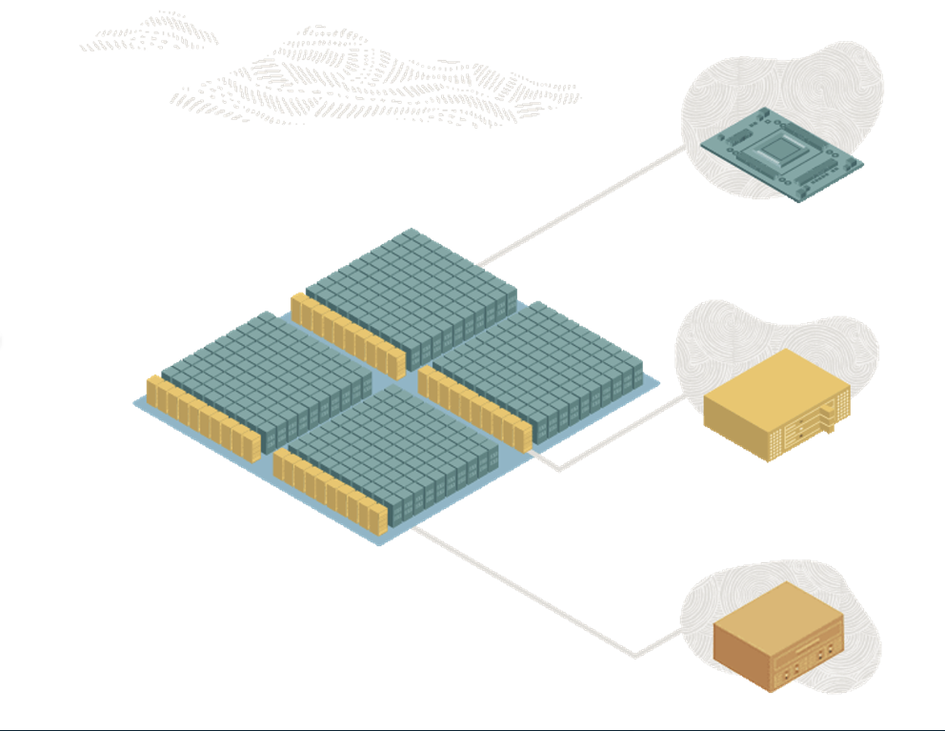
OCI AI Infrastructure
Built on Oracle’s unique Supercluster technology
Superior supercomputing performance
Dedicated AI Clusters certified by NVIDIA
Improves economics of training models
Efficient scalability
Scale up to 4096 instances and 32768 GPUs
Strong capabilities for varying AI workloads
Leading networking technology
Specialized purpose-built RDMA networking
Efficient and smooth processing of AI workloads
Notes:
Reserve dedicated hardware
Peace of mind knowing you have the compute resources you need
Predictable performance and pricing
Control the throughput / price tradeoff
Hosting and fine-tuning dedicated clusters available
On-demand pricing model also supported for pre-built models.
Besides being able to consume the pre-built models on demand (paying for the tokens you send/receive), OCI Generative AI is exposing a novel way that will enable enterprises with scalability need s. Generative AI customers will have the ability to reserve compute capacity for Generative AI workflows. In other words, the customer can pay a monthly price to have a set of compute resources that only the customer can use.
This brings the following advantages to you:
You can control the throughput / price tradeoff. For instance, if you need a higher throughput for your workload, you can simply increase the AI units allocated to your dedicated AI cluster.
You have full control of your monthly expenses, making it easier to get expense approvals, and reducing the chance of billing surprises.
Finally, this model gives you peace of mind knowing that you will have the resources you need for training and inferencing.

Slide 27
Oracle AI in Database

Slide 28
Oracle Modern Data Platform for AI
Prioritized data security and management
Tight control over data security and governance
Built for business
Models are tailored with industry-specific insights
Fine tune models for superior understanding
AI/ML is built-into the data management platform
Oracle Database, Autonomous Database, and MySQL HeatWave
Natural language interface to databases with Select AI
Built-in Vector Database to support AI workloads

Slide 29
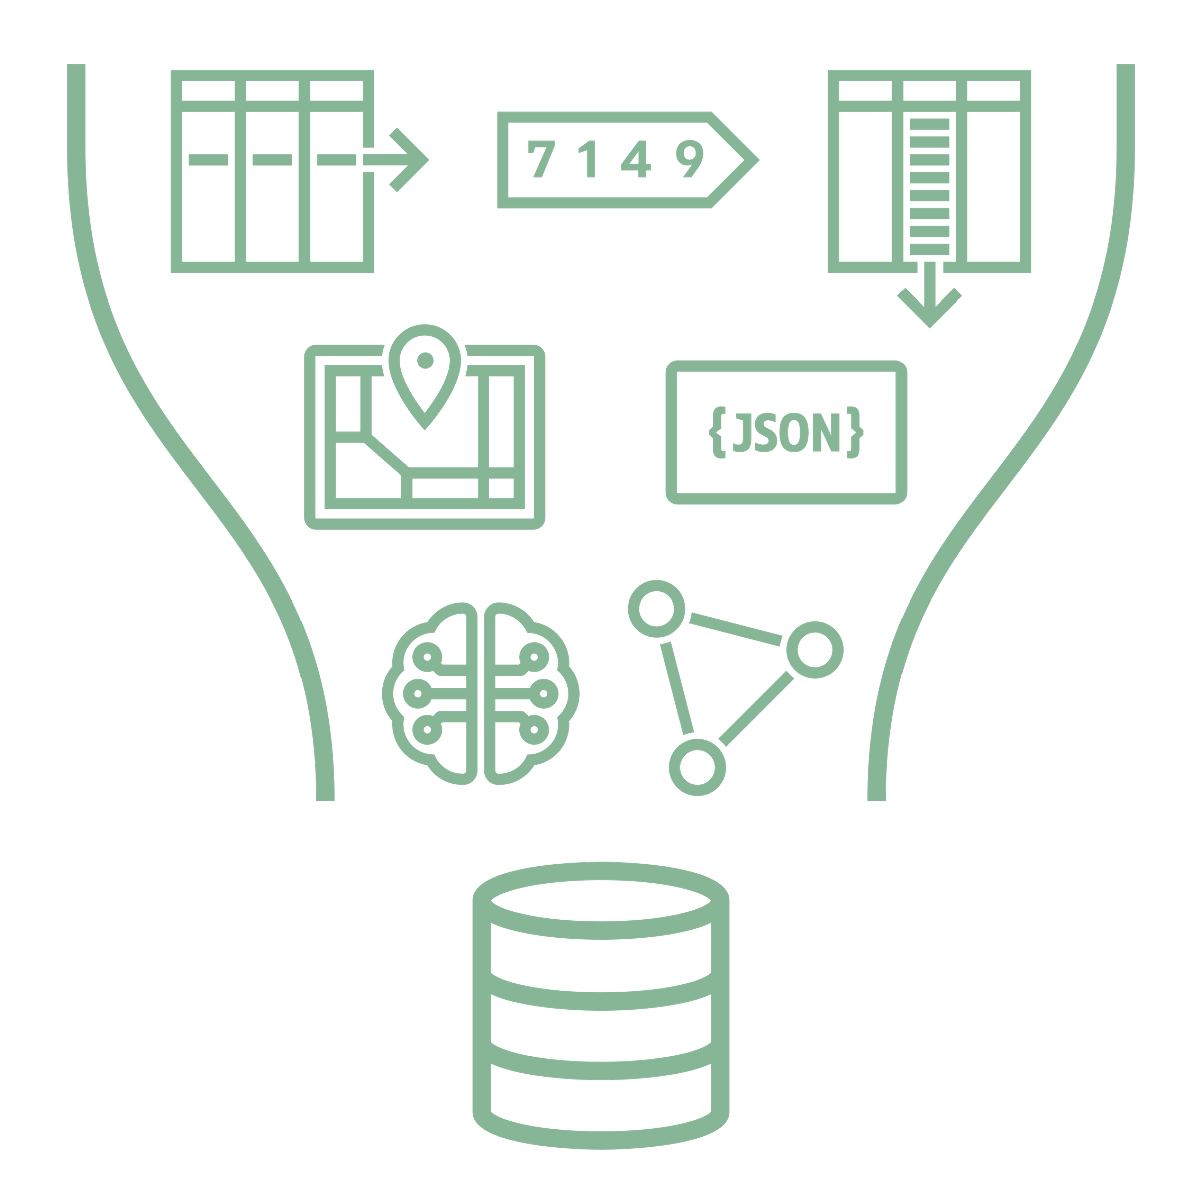

AI Vector Search/Store
Oracle Database 23c and MySQL HeatWave
Vectors are used to represent the semantic content of images, documents, videos, etc.
Converged database allows you to use both business data and vectors when answering a question
No need to move and synchronize data, manage multiple products, etc.
Converged Database

Slide 30





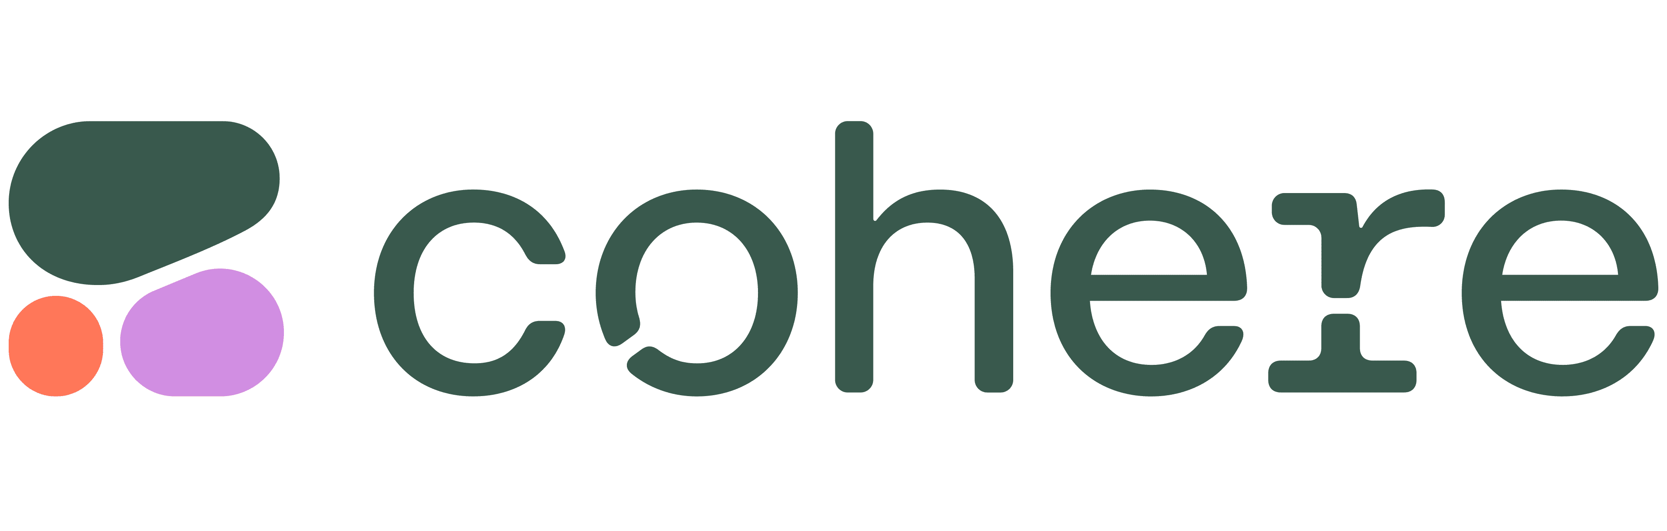
Vector Database and RAG
2
Vector DB finds private content (e.g. documents) that closely match the user's question
The user's question is encoded as a vector and sent to a Vector DB
1
User
Generative AI
GenAI uses the content plus general knowledge to provide an informed answer
4
3
The content is sent to the GenAI to help answer the user's question

Slide 31
Pervasive across Oracle apps
OCI Generative AI coming in Fusion Applications 24
Fusion Cloud HCM
Candidate Experience Summary
Compensation: Rewards and Recognition
Goal Creation
Survey Questions
Performance Feedback & Development Tips
Performance Review Summary
About Me for Connections
Job Category Landing Pages
Job Match Explanations
Feedback Assistance
Career Summaries for Oracle Grow
Creating SMART Team Goals
Fusion Cloud CX
Generate a Knowledge Article from a Source Doc
Generate a Knowledge Article from an SR
Assisted Content Creation for Interviews
Chat Agent Assistance
Chat Summarization
Issue/SR Summarization
SLO and Campaign Text Generation
Fusion Cloud SCM
Generate Item Descriptions and Attributes
Sourcing: New Supplier Recommendations for Negotiation Invitation
Notes:
OCI Generative AI also forms the basis for generative AI capabilities embedded across Oracle’s suite of SaaS applications, including Oracle Fusion Cloud Applications Suite, Oracle NetSuite, and industry applications such as Oracle Health. These AI capabilities are placed directly in the hands of your workforce via the software environments that they use every day, so they can achieve higher levels of productivity and effectiveness in their core tasks and workflows.
Fusion Applications will have new generative AI capabilities. Initial use cases focus on Summarization and Assisted Authoring, such as summarizing performance reviews, assisted authoring for job descriptions, assisted authoring for creating goals, writing knowledge articles, and generating relevant customer service emails. This tight collaboration between infrastructure, platform services, and applications enables a faster innovation cycle for Oracle customers worldwide.

Slide 32
Resources
Press Release
BLOGS
AI Agents RAG - What it is and potential use cases Technical - Deeper understanding of generative AI Strategy – What enterprises need to know
Data Science Quick Actions – What’s new in OCI Data Science
WEB PAGES
AI Agents
AI Services
Generative AI

Slide 33
Safe harbor statement
This presentation is intended to outline our general product direction. It is intended for information purposes only, and may not be incorporated into any contract. It is not a commitment to deliver any material, code, or functionality, and should not be relied upon in making purchasing decisions. The development, release, timing, and pricing of any features or functionality described for Oracle’s products may change and remains at the sole discretion of Oracle Corporation.
Statements in this presentation relating to Oracle’s future plans, expectations, beliefs, intentions, and prospects are “forward-looking statements” and are subject to material risks and uncertainties. A detailed discussion of these factors and other risks that affect our business is contained in Oracle’s Securities and Exchange Commission (SEC) filings, including our most recent reports on Form 10-K and Form 10-Q under the heading “Risk Factors.” These filings are available on the SEC’s website or on Oracle’s website at http://www.oracle.com/investor. All information in this presentation is current as of January 2024 and Oracle undertakes no duty to update any statement in light of new information or future events.

Slide 34
Thank you

